Slide 1

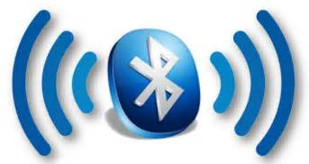
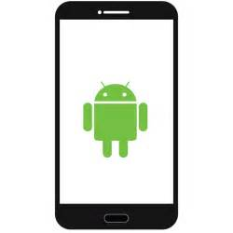
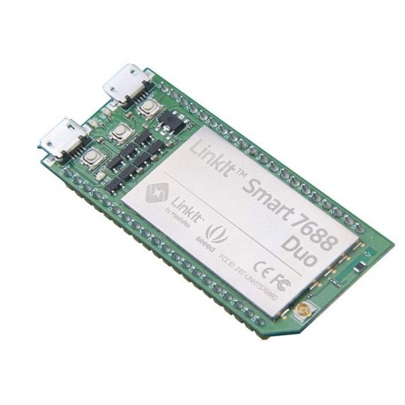
Bluetooth Low Energy: Indoor Positioning System

Slide 2

Agenda
Overview
Component Breakdown
Beacon
LinkIt
Server
App
Accuracy and Precision Summary
Conclusions
References

Slide 3
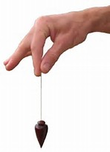

Problem: Losing items
Solution: Make an attachment that can be tracked from a phone.
Notes:
It will be attached to an item so that the item can be found if left behind somewhere
Unlike other trackers, it should give precise coordinate in 3 dimensions

Slide 4
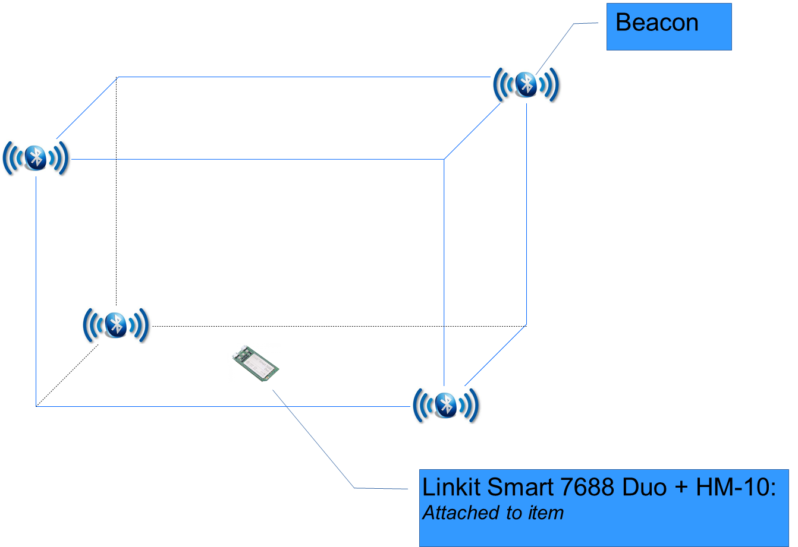
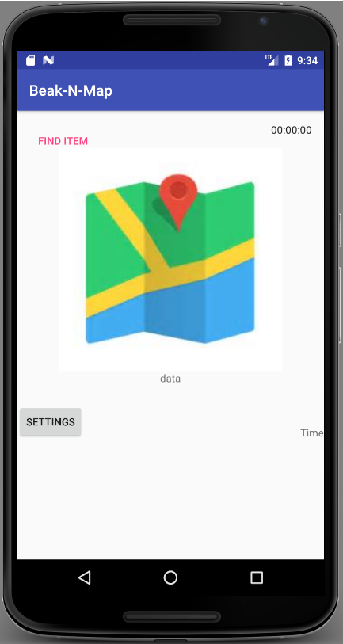


Overview
Server filters the RSSI
Calculates coordinates
Plots it on a map.
Beacons are placed in set positions
HM-10 scans for Bluetooth signals
LinkIt parses RSSI and sends it to the server
GETS map and data from server
Displays data time since update
Can select which chip to display and also rename chips

Slide 5
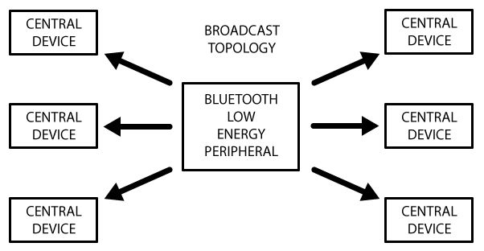
Beacons
OK+DISC | FactoryID(8) | UUID(32) | Major(4) Minor(4) Measured Power(2) | MAC(12) | RSSI(4)
Notes:
Hardware Transmitter
Uses Bluetooth Low Energy
Broadcasts Identifiers with Signal Strength (RSSI)

Slide 6
Beacons: Analysis
Beacons | RSSI Fluctuation w/ Obstacles (Office Setting) | RSSI Fluctuation w/o Obstacles (Hallway) | Configuration | Connection Stability | Power | Cost (RMB)
Seecky | ~ +/- 20 dBm Unreliable readings past 1 meter away from receiver | ~ +/- 15 dBm | Requires proprietary app Issues setting Major/Minor MAC address will change unprompted at times | Casing strongly affects signal transmission Often loses connection after 3-4 meters | Requires large coin batteries Supposed to last 3+ years at 500 ms 0dBm | ~40
HM-10 | ~ +/- 20 dBm Unreliable readings past 5 meters away from receiver | ~ +/- 10 dBm | Easy to configure with AT-Commands Requires TTL to USB computer and Arduino IDE More reliable and versatile | Fairly Stable | Requires TTL to USB converter Easy to switch out power source Much higher energy consumption | ~20-40
Ebeoo | ~ +/- 30 dBm Signal is often not found | ~ +/- 10 dBm | Requires proprietary app Unreliable (Changes in app do not always reflect changes in the beacon) | Often Unstable Loses signal at short ranges Sometimes require reboot to regain signal connection | Power source built in, hard to change | ~130
Xbee (hypothetical) | N/A | Claims 40 meter range outdoors with line of sight | Uses AT-Command More versatile (more txPowers to choose from) | Assumed to have fairly stable connection | Linked to Arduino Power | ~180-200
Notes:
Measured with phone app

Slide 7
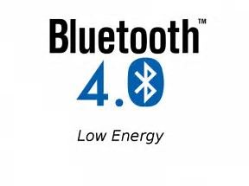
Beacons: Bluetooth Low Energy
Low Precision
Seekcy: Avg. Std. Dev. 2.39
HM-10: Avg Std. Dev. 3.78
Notes:
This can produce ~2m of error in lower RSSI (~-80) and around 1m at lower (~-40)

Slide 8
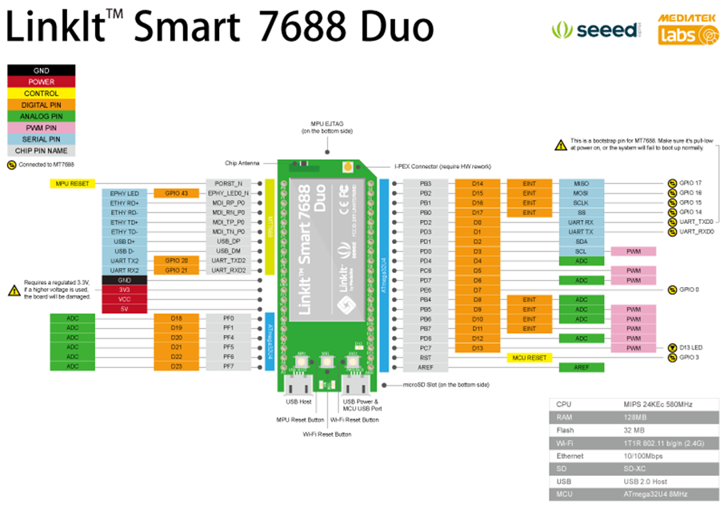
Open Development Board
Compatible with Arduino Yun Sketches
Has Onboard WiFi
Notes:
OpenWrt Linux Distro
Lacks Bluetooth
Can run at boot
Prototyping use

Slide 9
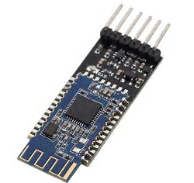
LinkIt: HM-10
Bluetooth Module
Used to give the LinkIt Bluetooth Functionality
Can be set as a Broadcaster or Receiver

Slide 10
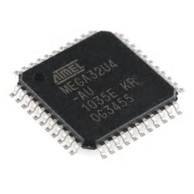
LinkIt: ATmega32U4
Runs Arduino Sketch
Sends Discovery Command to HM-10
Collects Discovery String and Sends it to the 7688
Limited in Memory and Processing Power

Slide 11
LinkIt: MT7688AN
Processes out the wanted RSSI signals and posts them to the server in JSON format
Uses OpenWrt
A stripped down Linux Distribution
Lacking in Utils and unable to run scipy/numpy

Slide 12

Server
RESTful Server
Stores most recent data
Handles:
POST request from LinkIt
GET request from APP

Slide 13
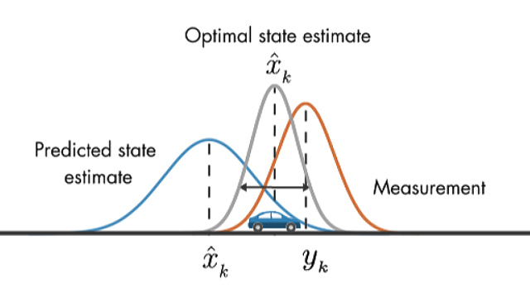
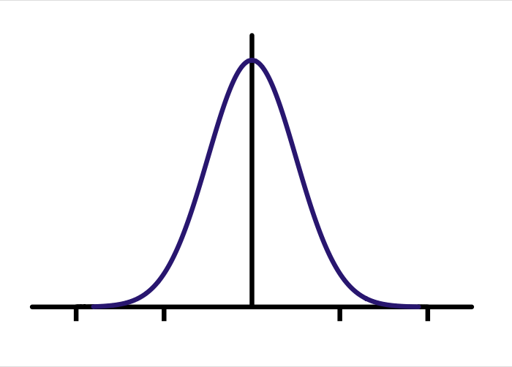
Server: RSSI Filtering
Android Beacon Library
Kalman Filtering

Slide 14
Server: RSSI Filtering
0.25 m | Unfiltered | Kalman | Android Beacon Library
Average RSSI | -45.4344 | -45.4435 | -47.3414
Std. Dev. | 3.251878 | 0.847493 | 2.693645
0.5 m | Unfiltered | Kalman | Android Beacon Library
Average RSSI | -58.3625 | -58.446 | -56.7732
Std. Dev | 2.124399 | 0.548445 | 1.038119
1 m | Unfiltered | Kalman | Android Beacon Library
Average RSSI | -58.3625 | -58.446 | -56.7732
Std. Dev | 2.124399 | 0.548445 | 1.038119
2 m | Unfiltered | Kalman | Android Beacon Library
Average RSSI | -63.1531 | -63.0549 | -58.1611
Std. Dev | 3.521101 | 0.583215 | 1.866448

Slide 15
Server: RSSI Filtering
Notes:
Note: Climbing Speeds and Smoothness

Slide 16
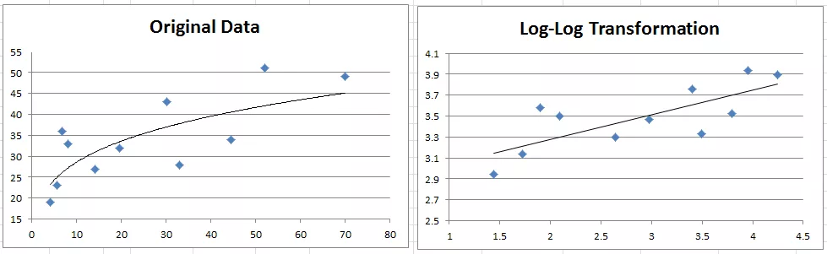
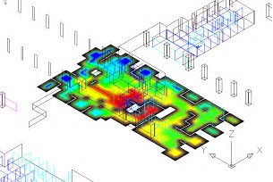
Server: RSSI to Meters

Slide 17
RSSI to Meters: HM-10 Calibration

Slide 18
RSSI to Meters: Seekcy Calibration

Slide 19
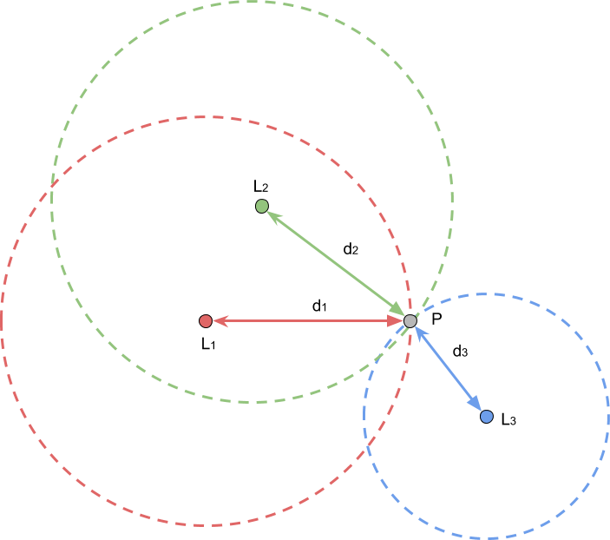
Server: Locating Function - Optimization
Notes:
How it Works vs Trilateration

Slide 20
Server: Location Accuracy
Accuracy:
Avg: +/- 0.327
Min: +/- 0.004 m
Max: +/- 0.785 m
Precision:
To 14 orders of significance

Slide 21
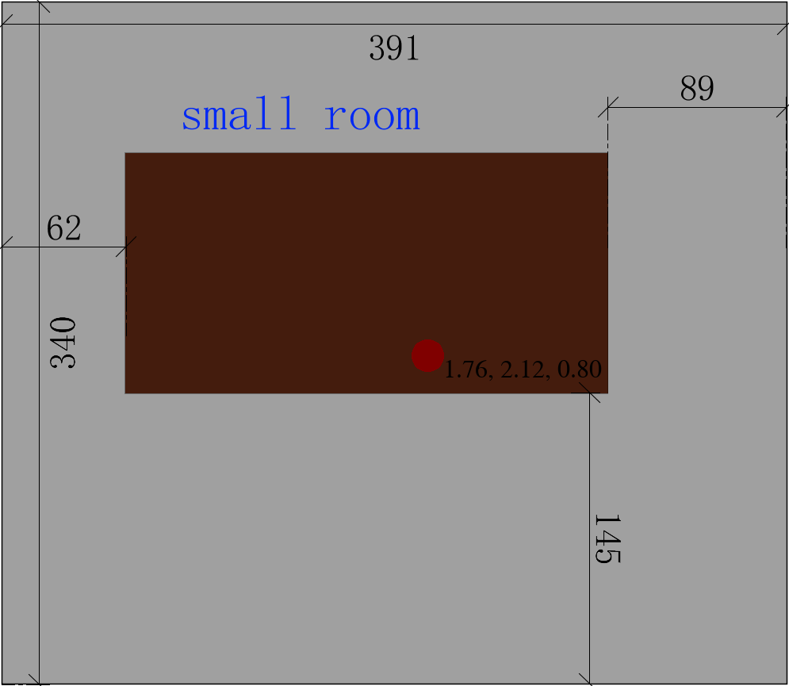


Server: Map Making

Slide 22
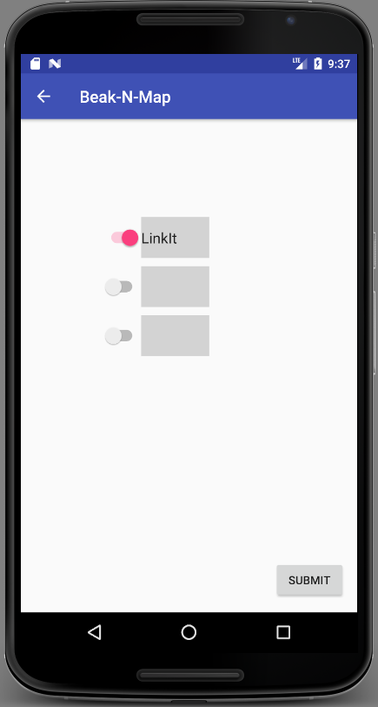
APP
Notes:
Note functions/Android App/
Beak-N-Map:
Android Application; Current functions include:
GET request to Server, to retrieve:
xyz coordinates of the object
.png file containing a map of the room with the position of the object indicated
time in seconds since epoch the xyz point and map was updated
Displays map, coordinates, time in human-readable format,and time since update
Settings:
Rename object ID
Determine which objects to display

Slide 23
Accuracy Summary
RSSI Scanning Precision (no obstacles) | Low Precision Seekcy: Average Std Dev 2.391937 This can produce ~2m of error in lower RSSI (~-80) and around 1m at lower (~-40) HM-10: Average Std Dev 3.776246794 Accuracy: Dependent on Environmental factors
RSSI Fluctuation Compensator | Testing Done with HM-10 Unfiltered Data Std Dev 2.402831 Average of last 20 data points (removing top & bottom 10%) Android Beacon Library Method Std. Dev 1.21705 Limited Kalman Filter Std. Dev 1.1421047
RSSI to Distance Conversion | Seekcy: Average +/- 0.7060m (min 0.009 max 4.6) HM-10: Average +/- 0.9595m (min 0.004 max 5.2) Possible to get lower error, but would reduce robustness Precision: Algorithm
Distance to Coordinates Accuracy/Precision | Accuracy (Assuming Accurate RSSI Values): Avg: +/- 0.327 Min: +/- 0.004 m Max: +/- 0.785 m Precision: to an order of 14
Notes:
Factors that greatly influence accuracy
RSSI fluctuation
RSSI's are restricted to whole numbers
Poor Calibration Formula (RSSI -meter)
Natural characteristic of a Bluetooth signal
Any obstruction will weaken signals
Objects located nearby will also scatter the signal

Slide 24
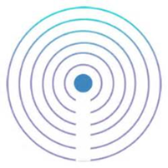
Conclusions
Creating an IPS is possible, but design changes need to made, depending on the final functionality
Most Beacon developers insist BLE is only useable for proximity detection and not precise distance-finding

Slide 25

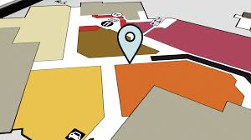
Future Considerations
RSSI Scanning:
Filter
RSSI-meter
Distance-to-Coordinate
Other Hardware Options
Notes:
RSSI Scanning:
Bluetooth and BLE don’t have the stability needed to perform indoor positioning properly
Easily has signal disrupted by surrounding objects and environmental factors
Naturally fluctuates
Ultrawide Band might be a better solution
Accuracy claimed to be up to 10 cm
Filter
There are other variations on the Kalman Filter
Filter is limited as there are no other sensors to make a prediction from
RSSI-meter
Can use RSSI directly instead of converting it first

Slide 26
References
HM-10:
http://www.blueluminance.com/HM-10-as-iBeacon.pdf
http://www.tinyosshop.com/datasheet/Tinysine%20Serial%20Bluetooth4%20user%20manual.pdf
LinkIt Smart 7688 Duo:
https://www.cnx-software.com/2015/12/01/quick-start-guide-for-linkit-smart-7688-board/
RSSI-distance Calibration
https://altbeacon.github.io/android-beacon-library/distance-calculations.html
http://www.real-statistics.com/regression/power-regression/
Kalman Filters:
https://www.wouterbulten.nl/blog/tech/kalman-filters-explained-removing-noise-from-rssi-signals/
Trilateration and Optimization
https://gis.stackexchange.com/questions/66/trilateration-using-3-latitude-and-longitude-points-and-3-distances/415#415
http://www.alanzucconi.com/2017/03/13/positioning-and-trilateration/
UWB vs BLE:
https://www.ncbi.nlm.nih.gov/pmc/articles/PMC4883398/
http://developer.radiusnetworks.com/2014/12/04/fundamentals-of-beacon-ranging.html

